Slide 1

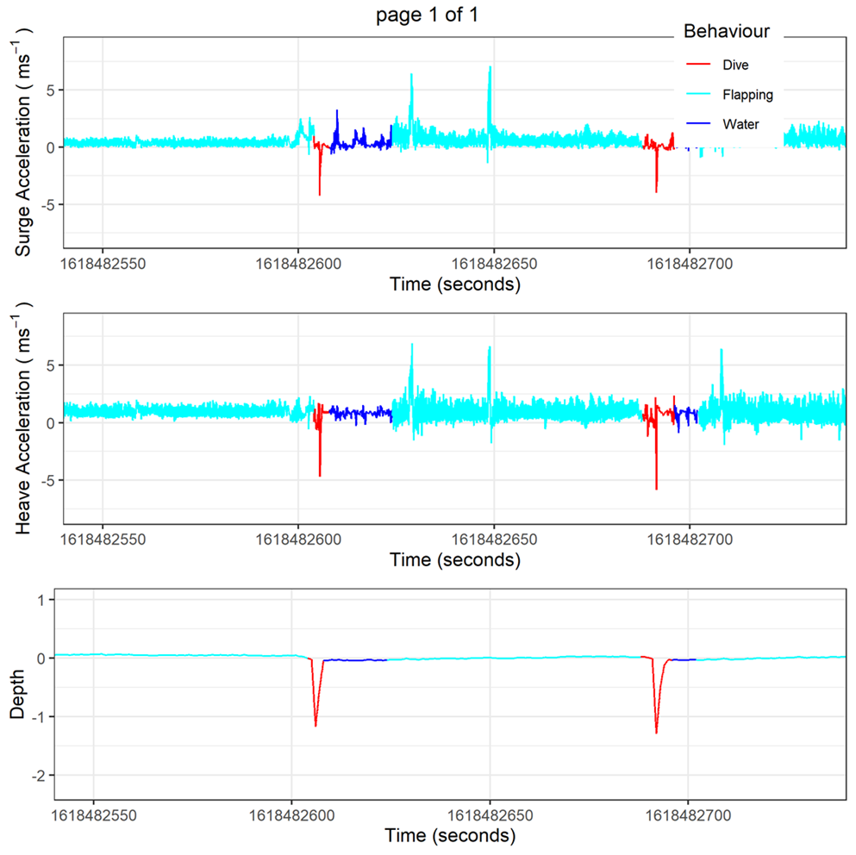
Data Curation, Handling, and Interpretation of Accelerometery Data: Day 3
SARAH SALDANHA, NUNO QUEIROZ, JESSICA HARVEY

Slide 2

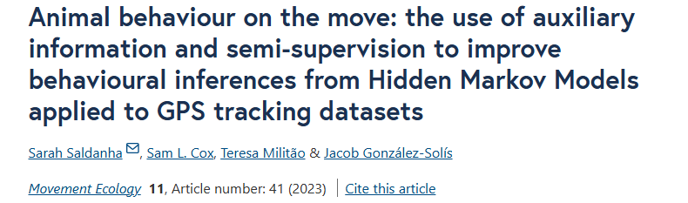







The use of auxiliary sensors to improve the behavioural classification of hidden Markov models for the study of the foraging ecology of red-billed tropicbirds
Sarah Saldanha, Sam Cox, Teresa Militão, Jacob González-Solís

Slide 3
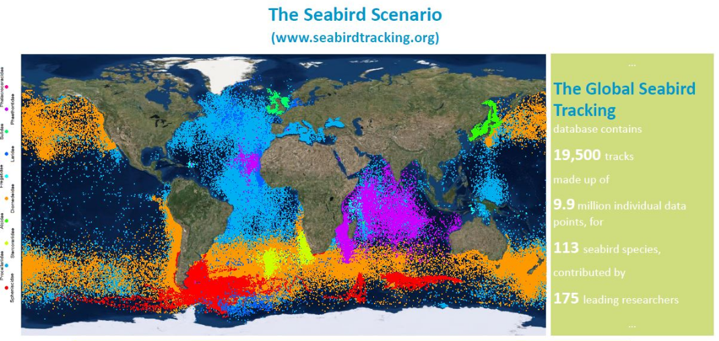
Tracking data
Notes:
Over the last three decades, advances in biologging technology, in particular the development of small, inexpensive and accurate gps devices, have facilitated rapid developments in the field of movement ecology, allowing for the study of movement in a wide array of seabrids while at sea. Along with these developments, several statistical methods and modelling approaches have been developed which mathematically analyse trajectories to infer, what segments of an animal’s track are spent in specific behaviours based on knowledge of their locomotion and ecology

Slide 4
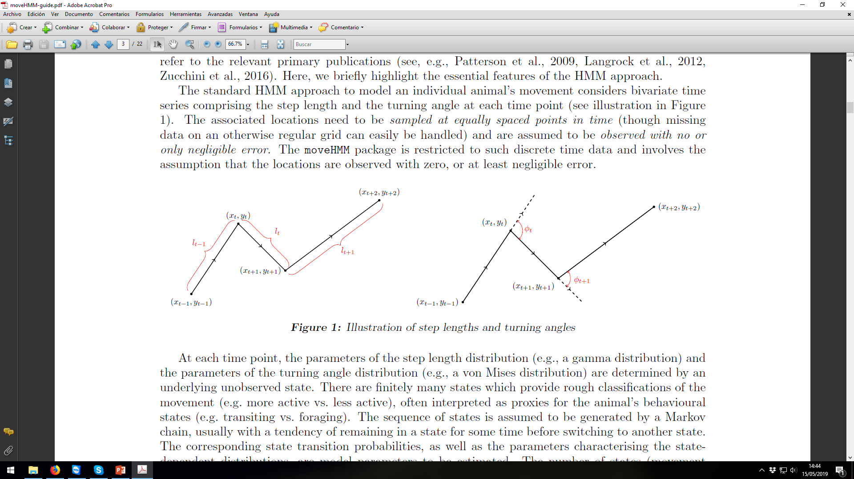
Infering behaviour from tracking data
Speed
resting/inactive
active
Notes:
While first studies used speed between gps positions to differentiate between when the animal WAS resting/inactive and active

Slide 5
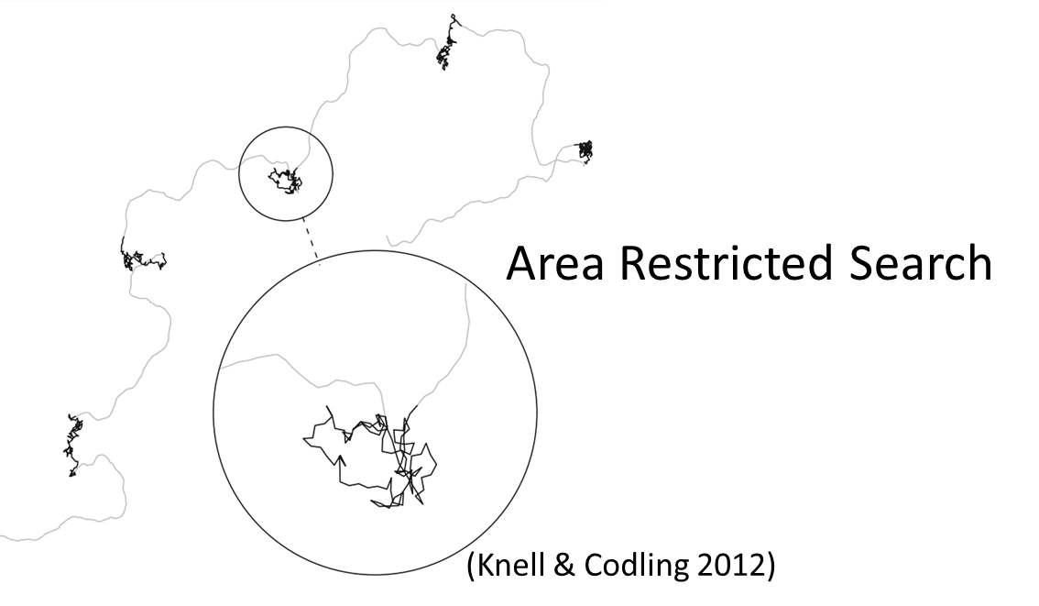
Infering behaviour from tracking data
Speed
resting/inactive
active
Foraging
Travelling
Angle
Notes:
Later, using the angle of movement in addition to speed, the active state is split into Foraging and Travelling based ON the theory of area restricted search which predicts that animals will move more slowly and with higher turning angle while foraging and faster and more direct during transit

Slide 6
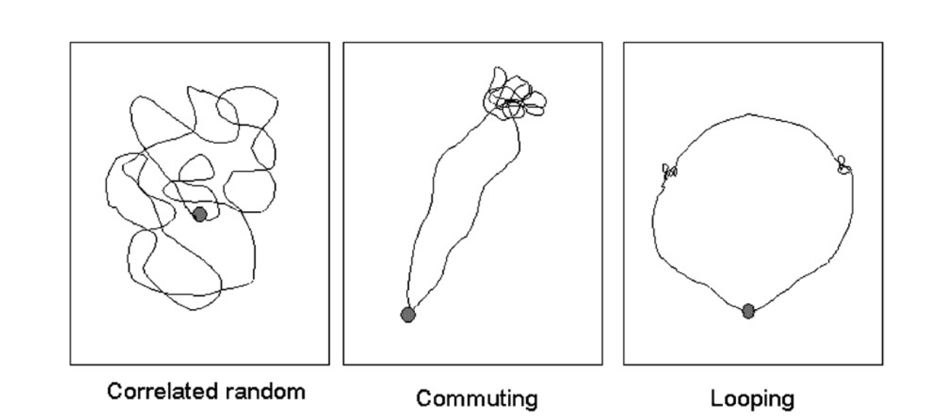
Commuting vs looping trips
(Weimerskirch 2007)
Notes:
While the use of area restricted search is well defined in seabirds with commuting trips, in birds with looping trips, the use of areas restricted search is more spread, with opportunistic foraging throughout the trip

Slide 7

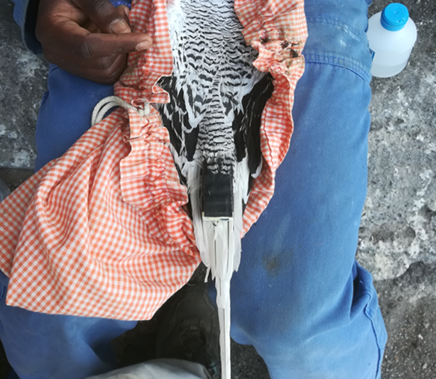
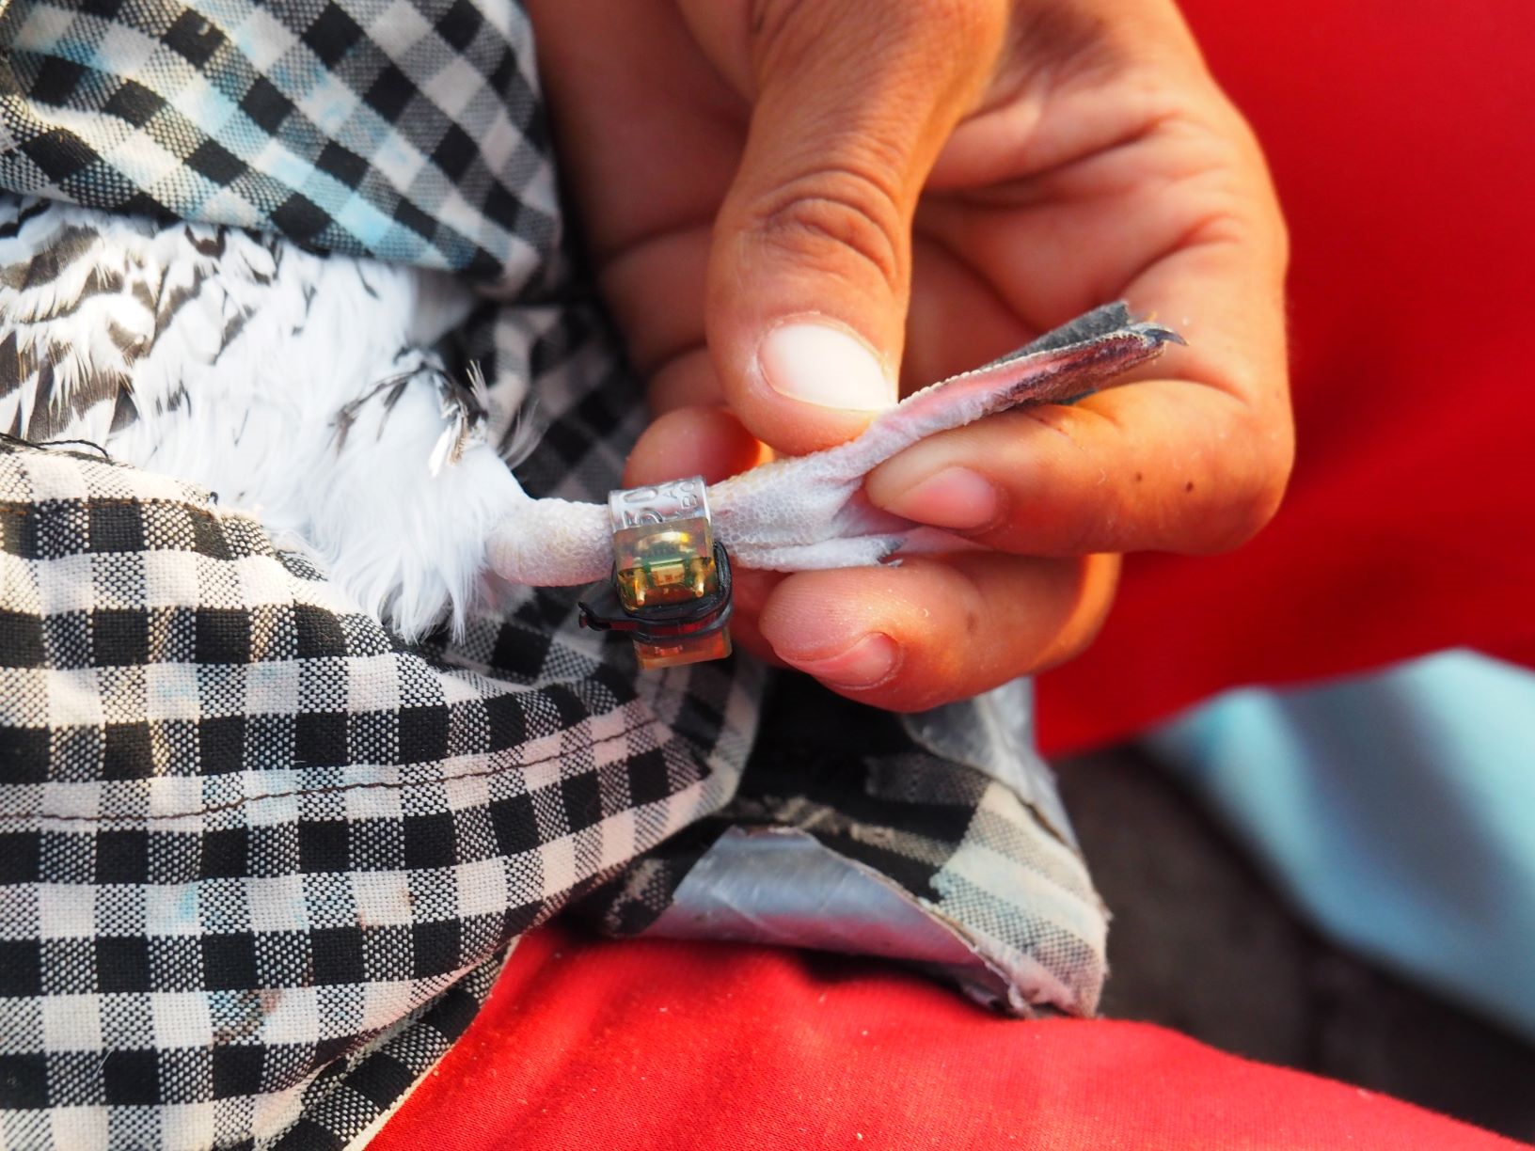

Cross-validation
Behavioural inference can be cross-validated by:
Notes:
While traditional methods of cross validation of behavioural inferances such as direct observation or vídeo footage can be used on land, to cross validate behaviours at sea, auxiliary devices such as accelerometers, time depth recorders or immersion loggers can be used.
Unfourtunately few studies cross validate the model inferences and rely mainly on the visual inspection and interpretation of the trips
Those that do fing that accuracy varies based on the type of model used, the gps fix interval, the species and their foraging strategy and the environment.

Slide 8
Cross-validation
Behavioural inference can be cross-validated by:
Few studies use cross-validation
Notes:
While traditional methods of cross validation of behavioural inferances such as direct observation or vídeo footage can be used on land, to cross validate behaviours at sea, auxiliary devices such as accelerometers, time depth recorders or immersion loggers can be used.
Unfourtunately few studies cross validate the model inferences and rely mainly on the visual inspection and interpretation of the trips
Those that do fing that accuracy varies based on the type of model used, the gps fix interval, the species and their foraging strategy and the environment.

Slide 9
Cross-validation
Behavioural inference can be cross-validated by:
Few studies use cross-validation
Those that do find that accuracy vary based on:
Model
GPS fix interval
Species and their foraging strategy
Environment
Notes:
While traditional methods of cross validation of behavioural inferances such as direct observation or vídeo footage can be used on land, to cross validate behaviours at sea, auxiliary devices such as accelerometers, time depth recorders or immersion loggers can be used.
Unfourtunately few studies cross validate the model inferences and rely mainly on the visual inspection and interpretation of the trips
Those that do fing that accuracy varies based on the type of model used, the gps fix interval, the species and their foraging strategy and the environment.

Slide 10

How to improve model output?
Sharp reduction of the GPS fix interval < 1s (not always possible)
Including additional auxiliary data (e.g accelerometer, wet-dry, TDR)
More costly
Weight limitations
Notes:
To improve the model output,
you can reduce the GPS fix interval, although this may not always be possible to to battery life restrictions,
can include auxiliary data to the models (acc. wet dry, tdr). Unfourtuately these devices are often costly and there might be weight and size limitations that restrict their Deployment alongsige a gps.

Slide 11
How to improve model output?
Sharp reduction of the GPS fix interval < 1s (not always possible)
Including additional auxiliary data (e.g accelerometer, wet-dry, TDR)
More costly
Weight limitations
Often only a subset of the GPS
Notes:
Becasue of this, when auxiliary data are present, they often only comprise a small subset of the complete GPS dataset

Slide 12
How to improve model output?
Sharp reduction of the GPS fix interval < 1s (not always possible)
Including additional auxiliary data (e.g accelerometer, wet-dry, TDR)
More costly
Weight limitations
Often only a subset of the GPS
Semi-supervision
Notes:
Here we explore whether these small subsets of auxiliary data can be used to imrpove model classification in hidden markov models

Slide 13
Objectives
Assess whether semi-supervision in HMMs:
increase model accuracy
equal between resting, foraging and travelling
reaches inference levels equal to commuting trips
Notes:
Specifically, we will assess whether semi supervisin HMM models can increase the overall model accruacy. if so, is the increase equal between the main behavioural modes of resting, foraging and travelling. and finally, is it possible to reach behavioural inferance levels equal to those of commuting trips with clear Area restricted search areas.

Slide 14
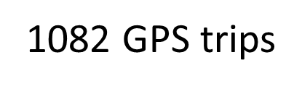
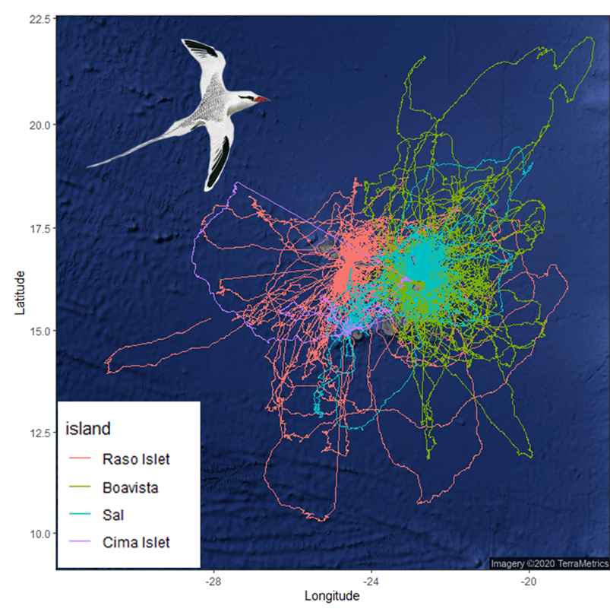



Methods
Notes:
To do this, we worked with a large GPS tracking data set of red billed tropicbirds breeding in Cabo Verde. As their name suggests, red-billed tropicbirds are tropical species which use large, looping trips to forage in relatively homegenous environaments.

Slide 15
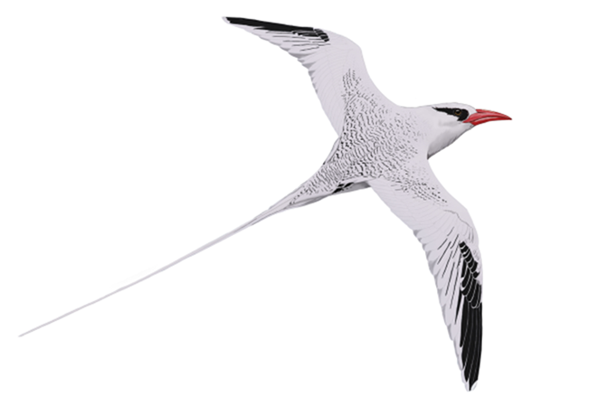
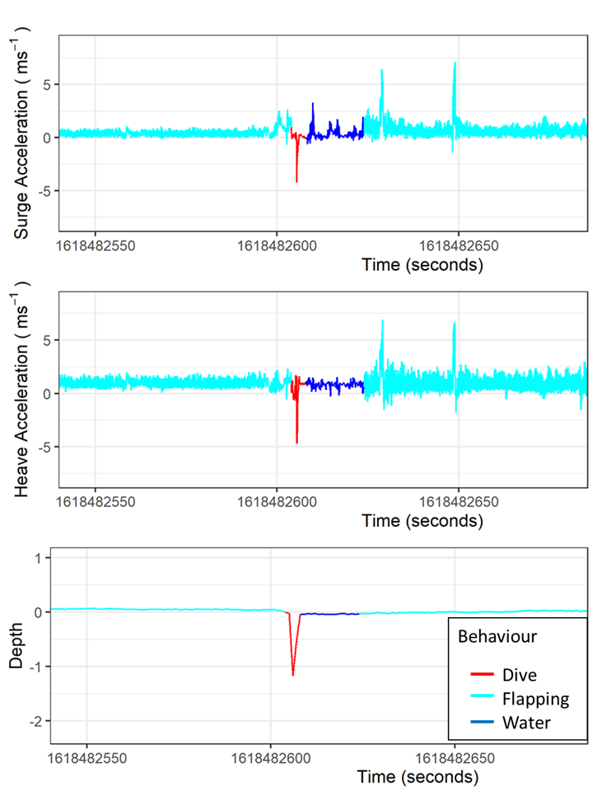
Methods
Auxiliary dataset:
acc +TDR (34 trips)
wet/dry (90 trips)
acc + TDR + wet/dry (16 trips)
Notes:
To semi-supervise this data set, we first matched our auxiliary dataset to each 5-min fix of the gps.

Slide 16
Methods
Auxiliary dataset:
acc +TDR (34 trips)
wet/dry (90 trips)
acc + TDR + wet/dry (16 trips)
resting, foraging or travelling
66% auxiliary data, 7.1% of full GPS
Notes:
Then we identified positions with known behaviours based on the auxiliary data ( for exemple when the wet/dry data was dry for the full 5 minutes we assumed the bird was resting on water. If there was a dive the bird was foraging and if the 5 min was constantly flapping that it was travellling)

Slide 17
Methods
Auxiliary dataset:
acc +TDR (34 trips)
wet/dry (90 trips)
acc + TDR + wet/dry (16 trips)
resting, foraging or travelling
66% auxiliary data, 7.1% of full GPS
leave out 10% for cross-validation X 10 itterations

Slide 18
Methods
Auxiliary dataset:
acc +TDR (34 trips)
wet/dry (90 trips)
acc + TDR + wet/dry (16 trips)
resting, foraging or travelling
56% auxiliary data, 6.3% of full GPS
left out 10% for cross-validation X 10 itterations

Slide 19
Methods
included an increasing proportion of positions with known states into HMMs

Slide 20
Methods
included an increasing proportion of positions with known states into HMMs
validated model inferences

Slide 21
Results & Discussion

Slide 22
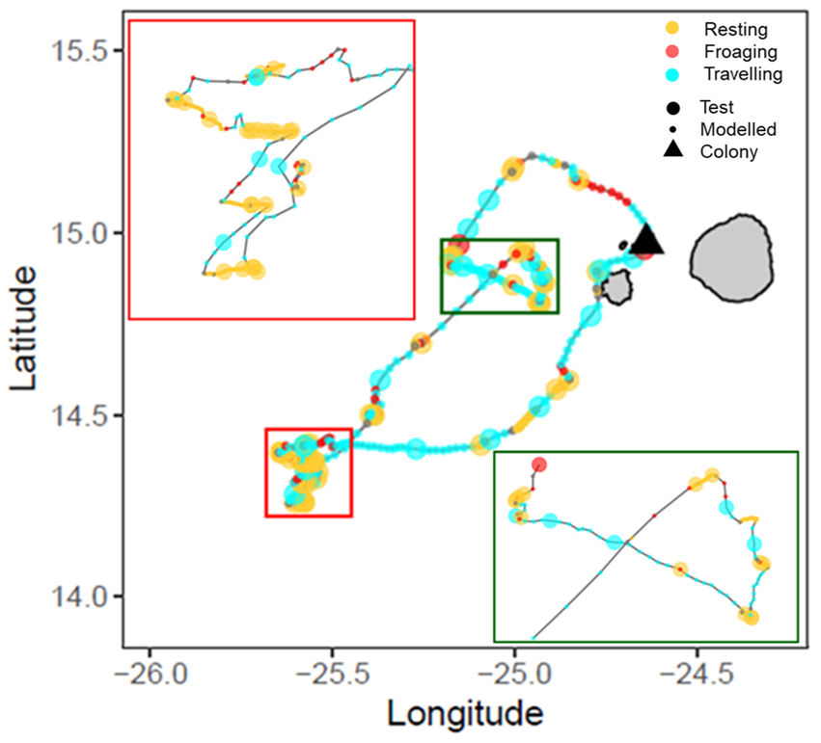
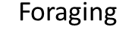

Behavioural Classification

Slide 23
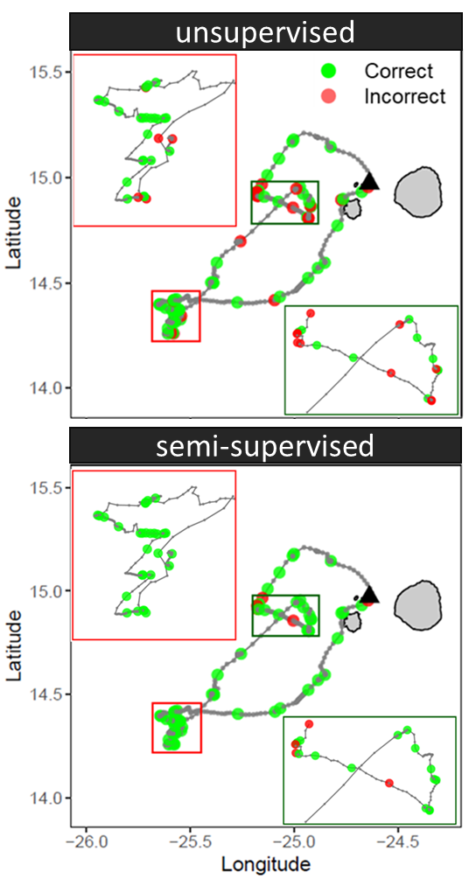
Behavioural Classification

Slide 24
Behavioural Classification
Fewer incorrect!

Slide 25
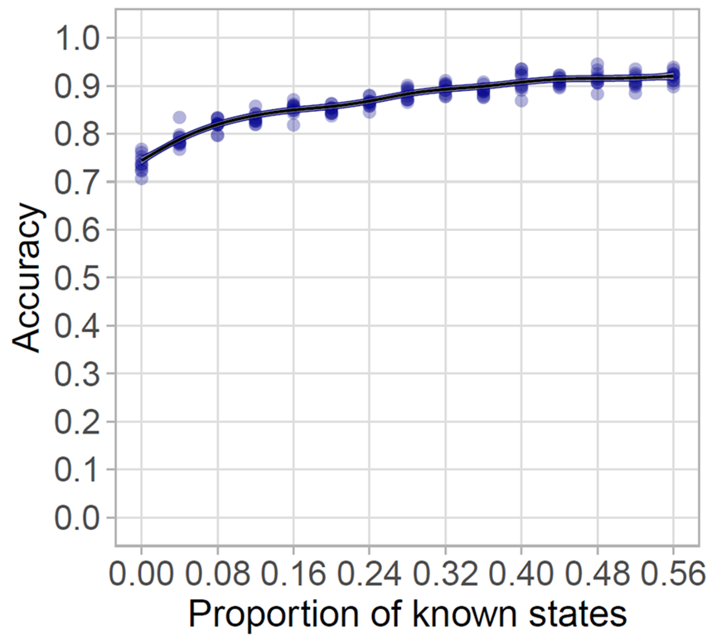
Increase from 0.74 ± 0.02 to 0.92 ± 0.01

Slide 26
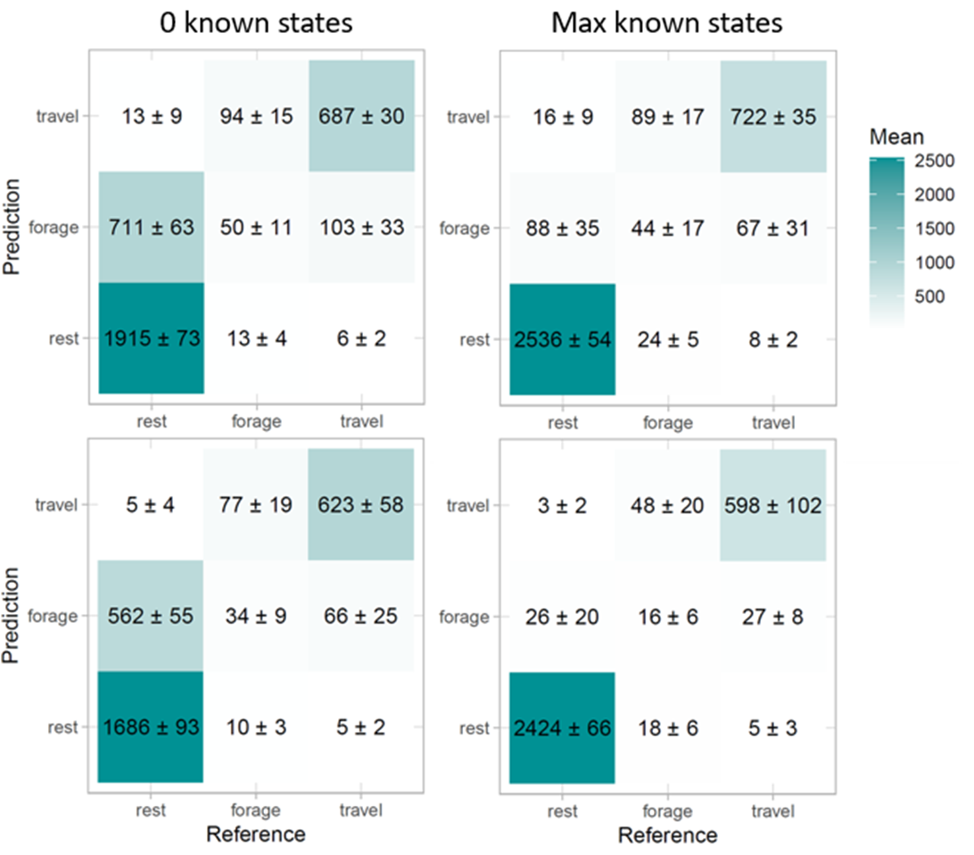
56%
Auxiliary dataset

Slide 27
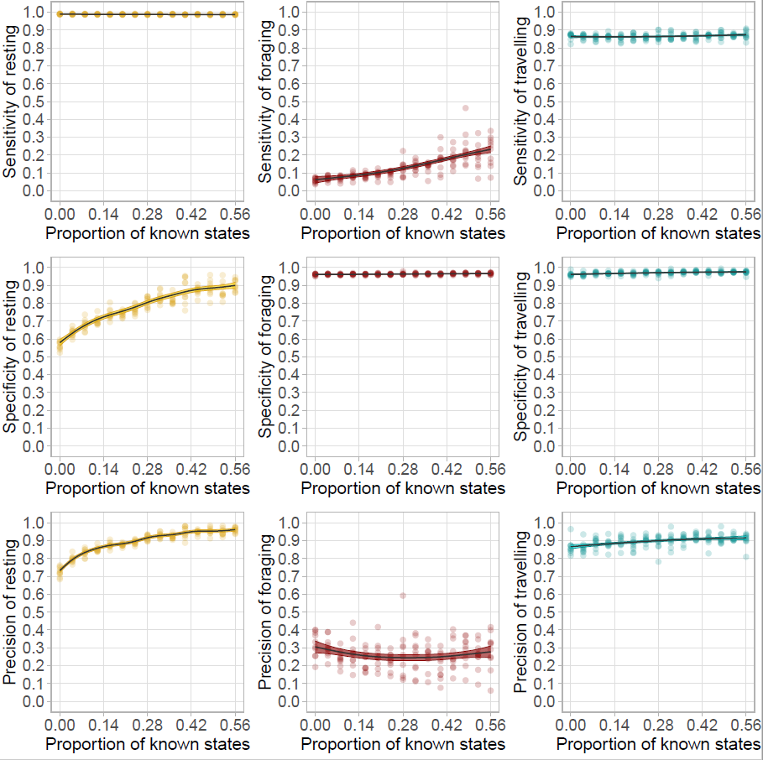
Sensitivity: Proportion of accurately predicted occurrences of a behaviour
Resting
Foraging
Travelling
Notes:
Sensitivity or the porpotion of accuracetly predicted occurences of behaviour increases the most for foraging although it remains low, suggesting that many foraging positions are going undetected. This can have consequences such as missing important foraging areas in spatial planing.

Slide 28
Specificity: Proportion of accurately predicted non-occurrences of a behaviour
Resting
Foraging
Travelling
Notes:
with semi-supervision, the specificity, or the proportion of accurately predicted non-occurances of a behaviour of resting increases greatly, while that of foraging and travelling remain relatively stable. This suggests that with increasing semi-supervision, foraging and travelling positions that were misclassified as resting are reduced.

Slide 29
Precision: Proportion of predicted occurences that are correct
Resting
Foraging
Travelling
Notes:
Finally for the precision, or the proportion of predicted occurences that are correct, we see am increase in resting and travellind while foraging remains relatively stable. Suggesting that many positions classified as foraging are actually either restign or travelling, which may be an issue for habitat use availability analysis

Slide 30
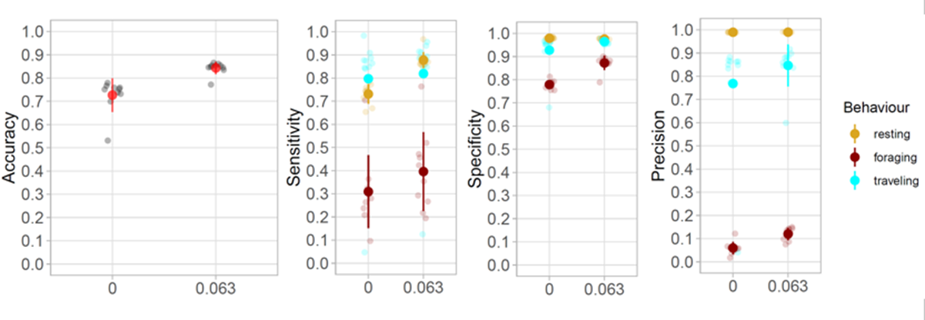
Full GPS model
Notes:
When semi-supervisin the complete GPS data set, we found similar paterns in the sensitivity, specificit and presicion of the behaviours.

Slide 31
Conclusions
Semi-supervision increased HMM accuracy

Slide 32
Conclusions
Resting
Foraging
Semi-supervision increased HMM accuracy
The increase uneven among behavioural modes
Specificity and precision of foraging mode
remained low
Specificity
Precision
Proportion of known states
Notes:
stronger increases in the sensitivity of resting and the specificity and precision of foraging, while travelling remained relatively stable. D
The behavioural inference levels of foraging remained low compared to those of species using commuting foraging trips, and may not be enough for the analysis of foraging habitat use and preferences.
Precaution should be taken in the identification and use of foraging behaviour in opportunistic foragers, such as tropical species which search for prey throughout looping trips within homogeneous environments.

Slide 33
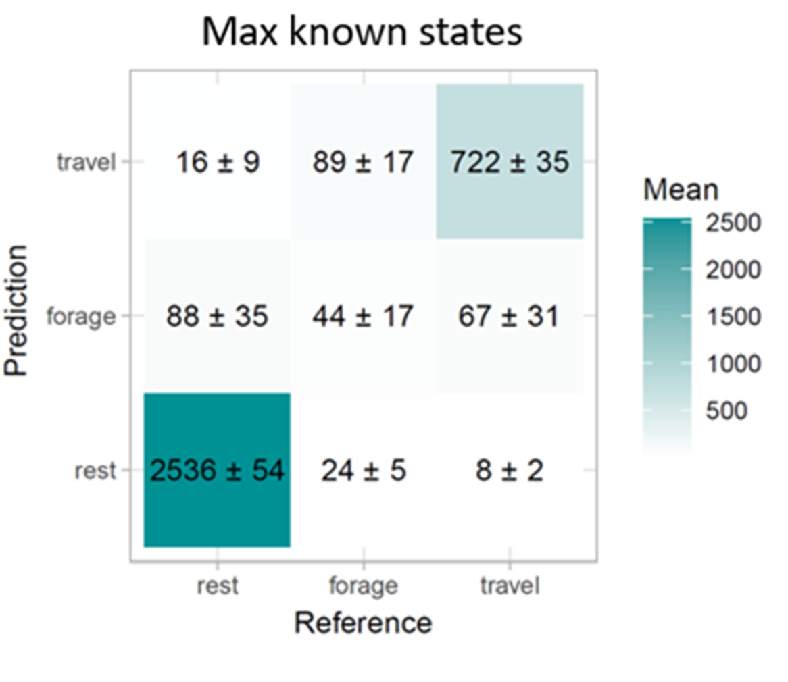
Conclusions
Semi-supervision increased HMM accuracy
The increase uneven among behavioural modes
Specificity and precision of foraging mode
remained low
Must be cautions with opportunistic foragers!
Notes:
stronger increases in the sensitivity of resting and the specificity and precision of foraging, while travelling remained relatively stable.
The behavioural inference levels of foraging remained low compared to those of species using commuting foraging trips, and may not be enough for the analysis of foraging habitat use and preferences.
Precaution should be taken in the identification and use of foraging behaviour in opportunistic foragers, such as tropical species which search for prey throughout looping trips within homogeneous environments.

Slide 34
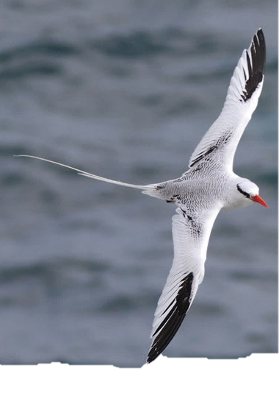
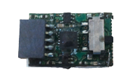
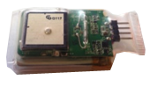
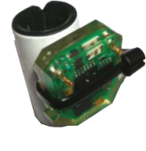
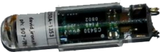
Conclusions
Semi-supervision increased HMM accuracy
The increase uneven among behavioural modes
Specificity and precision of foraging mode
remained low
Must be cautions with opportunistic foragers!
Choice of auxiliary sensors based on specific
ecology of species, processing time and costs
GPS
Accelerometer
Geolocator
TDR
Notes:
stronger increases in the sensitivity of resting and the specificity and precision of foraging, while travelling remained relatively stable. D
The behavioural inference levels of foraging remained low compared to those of species using commuting foraging trips, and may not be enough for the analysis of foraging habitat use and preferences.
Precaution should be taken in the identification and use of foraging behaviour in opportunistic foragers, such as tropical species which search for prey throughout looping trips within homogeneous environments.

Slide 35
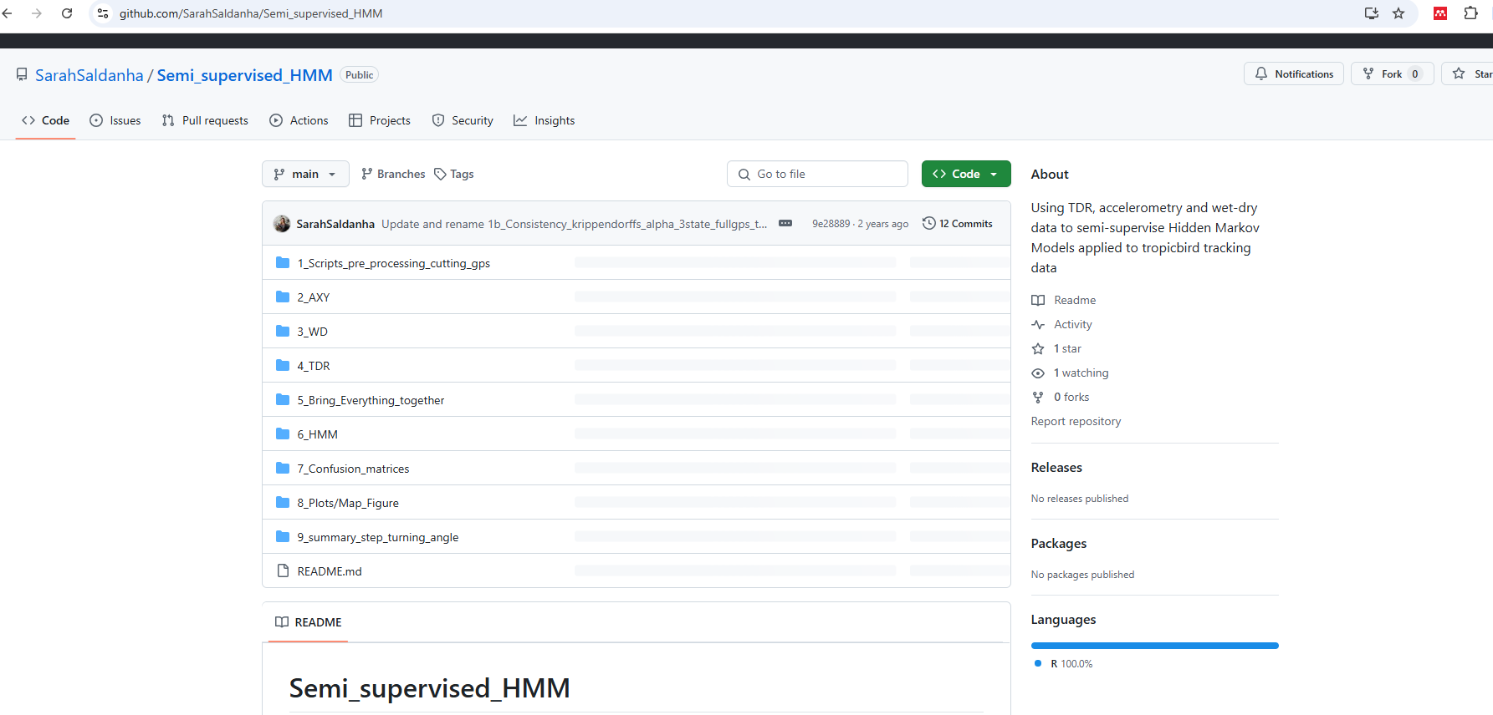
Work Flow

Slide 36
Work Flow
1_Scripts_pre_processing_cutting_gps: Scripts to interpolate GPS tracks to 5 minutes to prepare the data for the HMMs
2_AXY: Adapted script from PM Collins (2015), later modified by B Clark (2018) for the Grupo Aves Marinas Course to calculate metrics from the accelerometry data and run a random forest model to classify accelerometry and TDR data into flapping flight, resting and diving
3_WD: Adapted script from Z. Zajkova to extract 6s migrate GLS wet-dry data and match this data to GPS positions.
4_TDR: Clean TDR data using the package diveMove to extract number and duration of dives.
5_Bring_Everything_together: Combined GPS, WD, TDR and accelerometry data create known states dataset
6_HMM run HMMs on the informed dataset and on the full GPS dataset
7_Confusion_matrices: create and plot confusion matrices for the results of the HMM models
8_Plots: plot the results of the HMM supervision onto a map
9_summary_step_turning_angle: summarize step and turning angle of the HMM models to visualize how they are affected by semi-supervision.

Slide 37
Work Flow
1_Scripts_pre_processing_cutting_gps: Scripts to interpolate GPS tracks to 5 minutes to prepare the data for the HMMs
2_AXY: Adapted script from PM Collins (2015), later modified by B Clark (2018) for the Grupo Aves Marinas Course to calculate metrics from the accelerometry data and run a random forest model to classify accelerometry and TDR data into flapping flight, resting and diving
3_WD: Adapted script from Z. Zajkova to extract 6s migrate GLS wet-dry data and match this data to GPS positions.
4_TDR: Clean TDR data using the package diveMove to extract number and duration of dives.
5_Bring_Everything_together: Combined GPS, WD, TDR and accelerometry data create known states dataset
6_HMM run HMMs on the informed dataset and on the full GPS dataset
7_Confusion_matrices: create and plot confusion matrices for the results of the HMM models
8_Plots: plot the results of the HMM supervision onto a map
9_summary_step_turning_angle: summarize step and turning angle of the HMM models to visualize how they are affected by semi-supervision.

Slide 38
Work Flow
1_Scripts_pre_processing_cutting_gps: Scripts to interpolate GPS tracks to 5 minutes to prepare the data for the HMMs
2_AXY: Adapted script from PM Collins (2015), later modified by B Clark (2018) for the Grupo Aves Marinas Course to calculate metrics from the accelerometry data and run a random forest model to classify accelerometry and TDR data into flapping flight, resting and diving
3_WD: Adapted script from Z. Zajkova to extract 6s migrate GLS wet-dry data and match this data to GPS positions.
4_TDR: Clean TDR data using the package diveMove to extract number and duration of dives.
5_Bring_Everything_together: Combined GPS, WD, TDR and accelerometry data create known states dataset
6_HMM run HMMs on the informed dataset and on the full GPS dataset
7_Confusion_matrices: create and plot confusion matrices for the results of the HMM models
8_Plots: plot the results of the HMM supervision onto a map
9_summary_step_turning_angle: summarize step and turning angle of the HMM models to visualize how they are affected by semi-supervision.

Slide 39
Work Flow
1_Scripts_pre_processing_cutting_gps: Scripts to interpolate GPS tracks to 5 minutes to prepare the data for the HMMs
2_AXY: Adapted script from PM Collins (2015), later modified by B Clark (2018) for the Grupo Aves Marinas Course to calculate metrics from the accelerometry data and run a random forest model to classify accelerometry and TDR data into flapping flight, resting and diving
3_WD: Adapted script from Z. Zajkova to extract 6s migrate GLS wet-dry data and match this data to GPS positions.
4_TDR: Clean TDR data using the package diveMove to extract number and duration of dives.
5_Bring_Everything_together: Combined GPS, WD, TDR and accelerometry data create known states dataset
6_HMM run HMMs on the informed dataset and on the full GPS dataset
7_Confusion_matrices: create and plot confusion matrices for the results of the HMM models
8_Plots: plot the results of the HMM supervision onto a map
9_summary_step_turning_angle: summarize step and turning angle of the HMM models to visualize how they are affected by semi-supervision.

Slide 40
Work Flow
1_Scripts_pre_processing_cutting_gps: Scripts to interpolate GPS tracks to 5 minutes to prepare the data for the HMMs
2_AXY: Adapted script from PM Collins (2015), later modified by B Clark (2018) for the Grupo Aves Marinas Course to calculate metrics from the accelerometry data and run a random forest model to classify accelerometry and TDR data into flapping flight, resting and diving
3_WD: Adapted script from Z. Zajkova to extract 6s migrate GLS wet-dry data and match this data to GPS positions.
4_TDR: Clean TDR data using the package diveMove to extract number and duration of dives.
5_Bring_Everything_together: Combined GPS, WD, TDR and accelerometry data create known states dataset
6_HMM run HMMs on the informed dataset and on the full GPS dataset
7_Confusion_matrices: create and plot confusion matrices for the results of the HMM models
8_Plots: plot the results of the HMM supervision onto a map
9_summary_step_turning_angle: summarize step and turning angle of the HMM models to visualize how they are affected by semi-supervision.

Slide 41

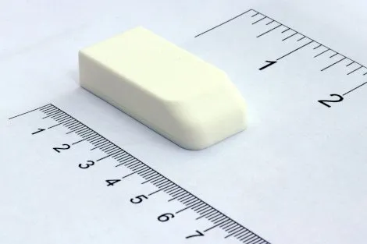
Device
AxyTreck:
GPS data (5 min)
Time Depth Recorder (1s)
Accelerometry (25Hz)

Slide 42
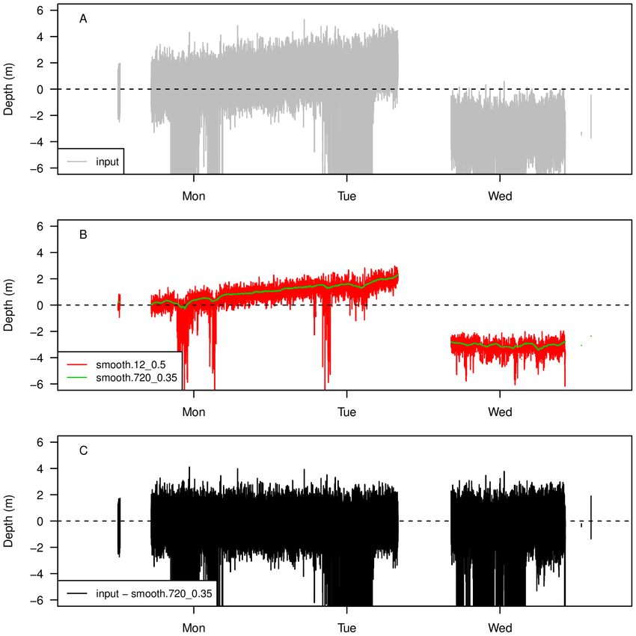
DiveMove
https://cran.r-project.org/web/packages/diveMove/vignettes/diveMove.html
DiveMove Package allows you to:
callibrate depth readings to correct for shifts in the pressure transducer
calculate dive statistics (# dives, maximum depth, dive duration, bottom time, post-dive duration, and summaries for each dive phase, among other standard dive statistics)
plotly plots to visualize the entire dive record

Slide 43
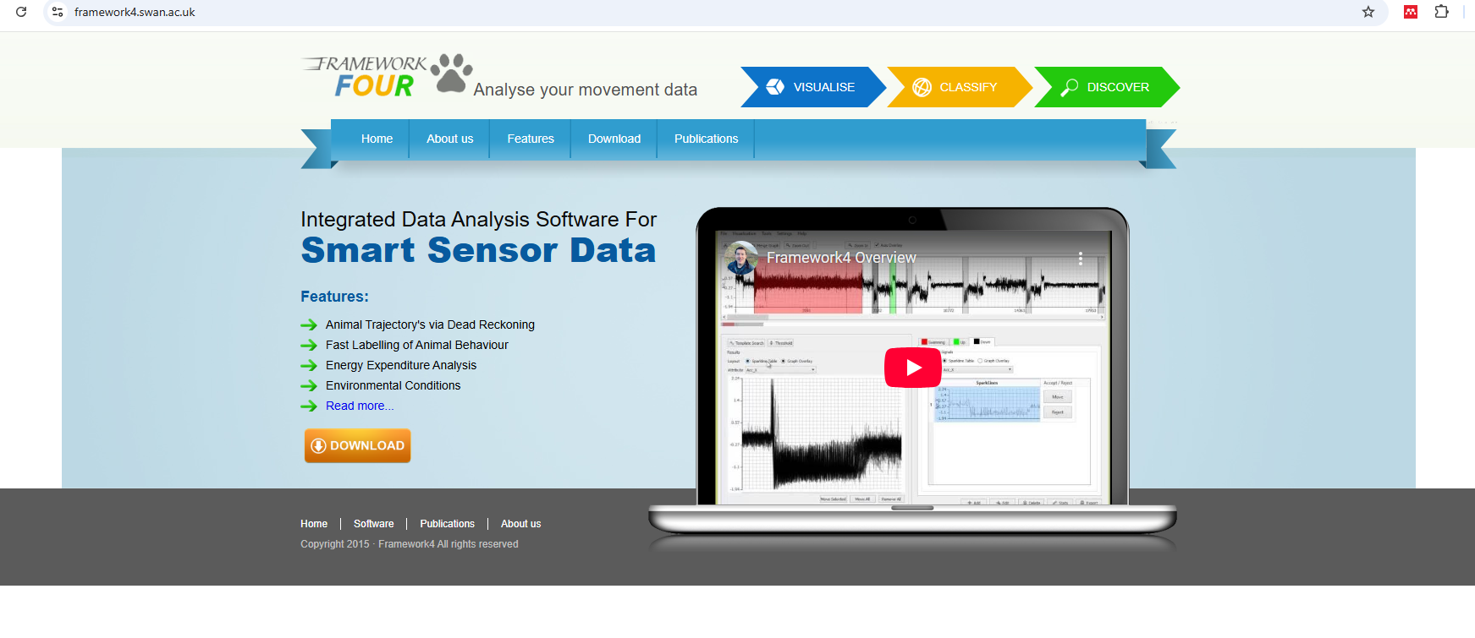
Framework4

Slide 44
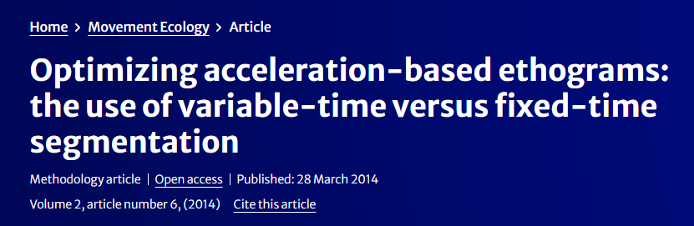
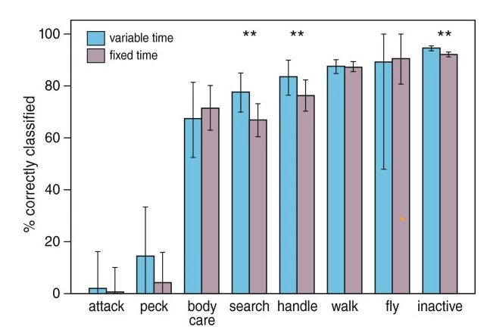
Variable-time segmentation

Slide 45
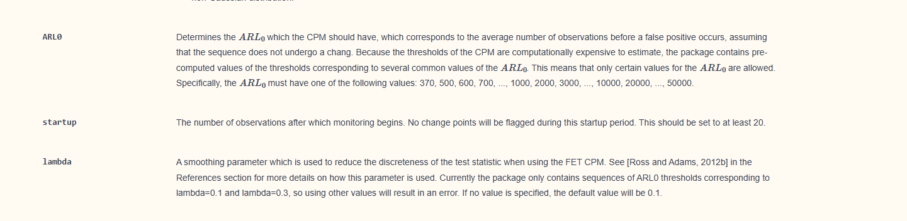
Variable-time segmentation

Slide 46
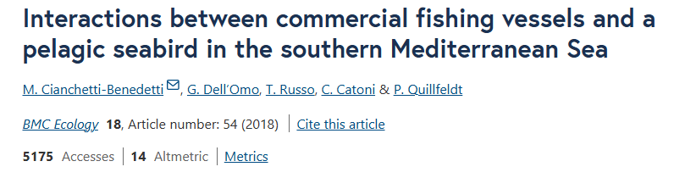
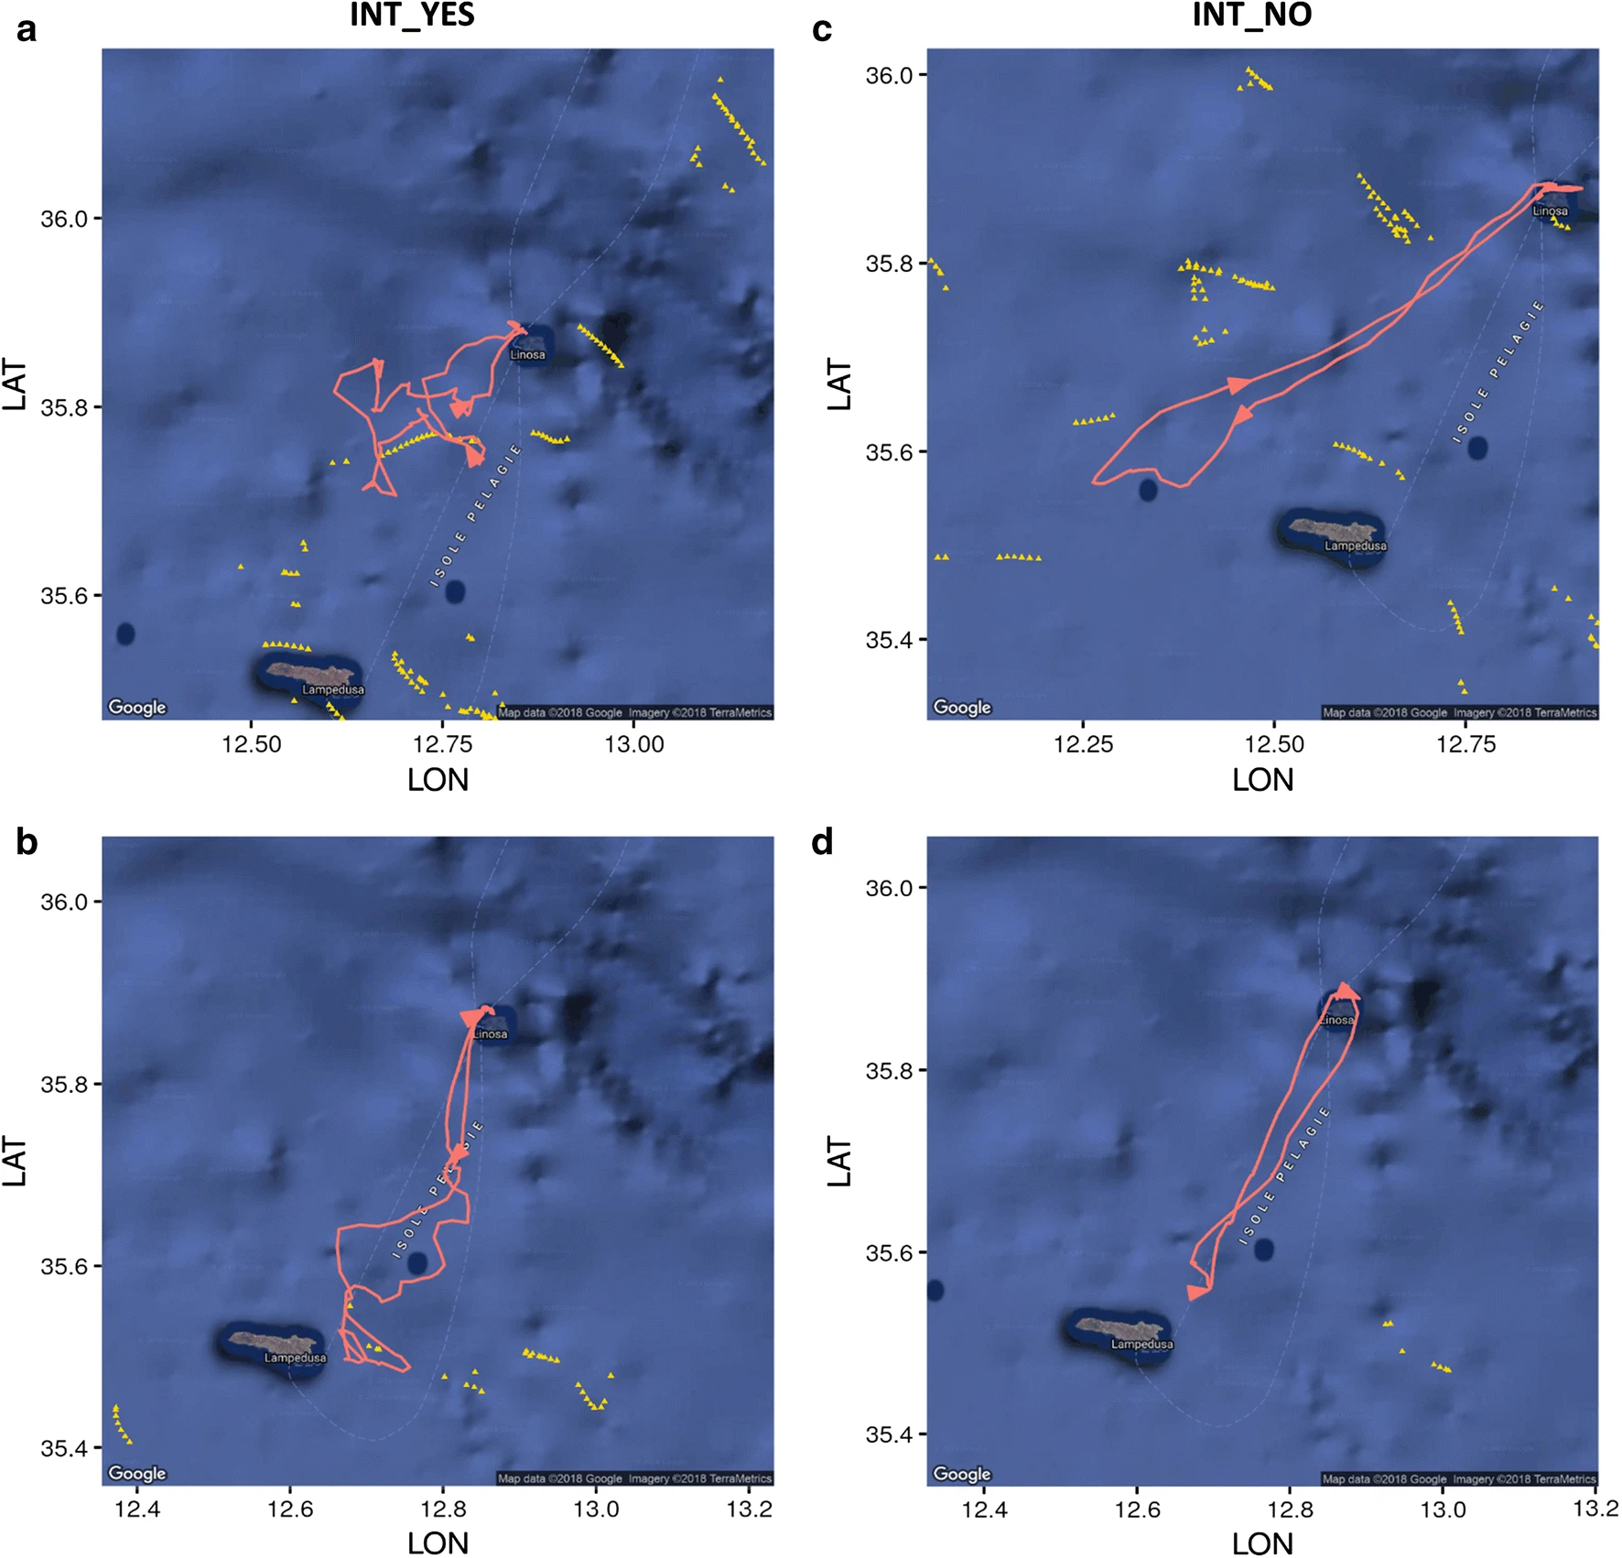
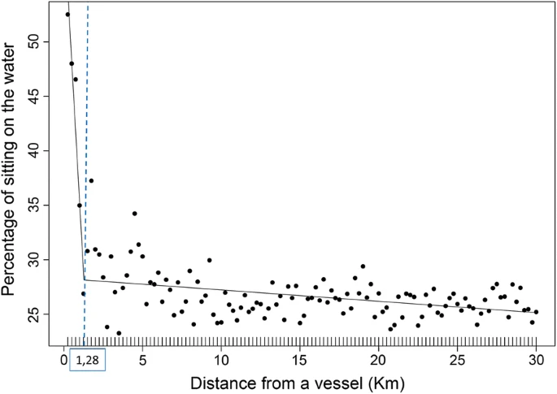
Some Final Examples

Slide 47
Some Final Examples
Difference between foraging behaviour at vessels vs natural?

Slide 48
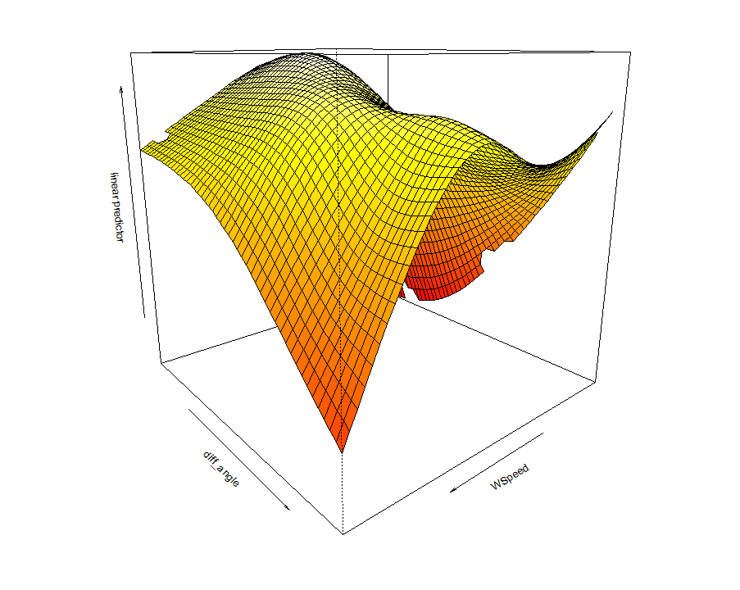
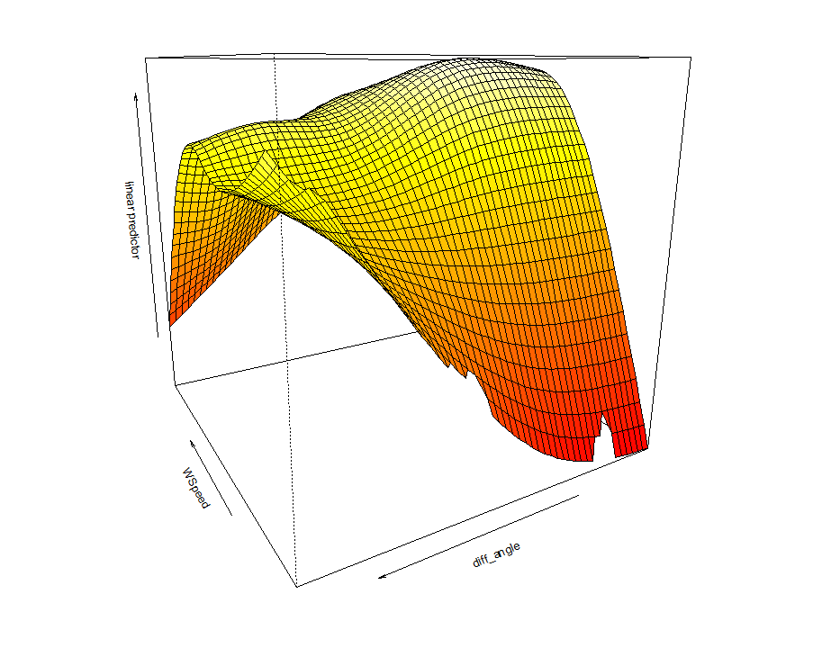
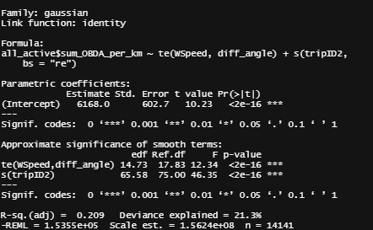
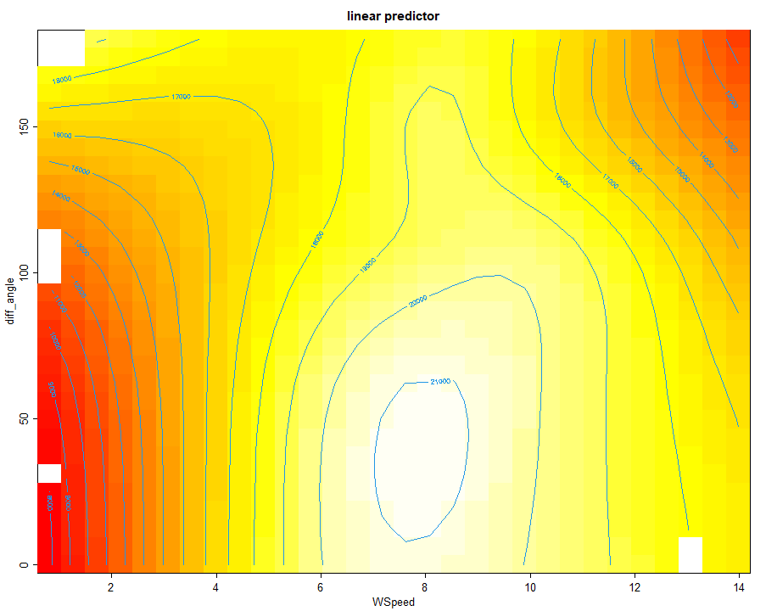
Some Final Examples
Some Final Examples
So what predicts energy expenditure/KM?
Highest energy expenditure

